Slide 1


Slide 2
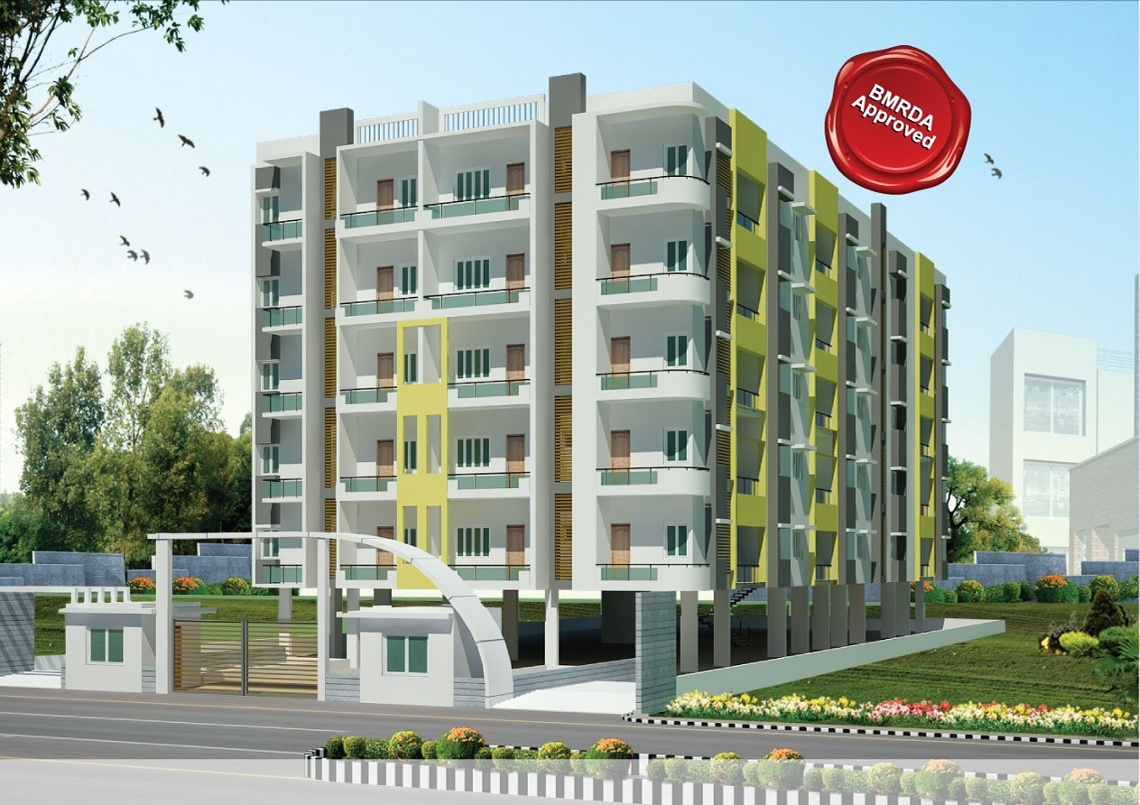
Gracious living with spacious interiors always invites you to the comfortable life

Slide 3
Description: -
Gracious living with spacious interiors always invites you to the comfortable life with all kinds of comforts and amenities at a home situated at a great developing neighbourhood with abundant environs and green spaces.
This residential project presents 2/3/BHK apartments ranging from 860 sq ft - 1340 sq ft.
GCA Rainbow is a complex of 40 well-designed 2 & 3 Bedroom Apartments that sprawl across 5 floors.
BMRDA approved
Possession: August 2014
Location: Chandapura circle
(5 Min drive from chandapura circle towards Attibele)

Slide 4
Amenities:-
Kids Swimming Pool
Children Play Area
Gym
Party Hall & Clubhouse
Landscaped Area
Intercom
Power Backup
24 hours Security
Covered Car Parking
2 Lifts
STP

Slide 5
Specification:-
Structure: RCC framed structure
Walls: Solid Block
Roof: 6” thick roof with required reinforcement.
Flooring: Vitrified tiles for living, balcony, kitchen, & Bed room, antiskid tiles for bath room.
Doors & windows:
Main Door: Frame with section of 5” X 3” thick with Teak
OST shutter. Lock Godrej make with brss fittings.
All other Doors of Red sal wood frame section of 4” X 2.5”
Thick with commercial flush shutters
Powder coated aluminum windows.
Window grill will be of 10 mm square rods

Slide 6
Kitchen:
Kitchen platform with 30mm thick. Black granite with half bull nosing.
SS sink of single bowl & drain-board
2 ft high dadoing above the platform of glazed ceramic tiles
Toilets/ bath Room:
One wall mixer (2 in 1) of ISI brand
One wash basin of Hindware make with one pilla cock
One shower & 2 pillar cock, one floor trap & one Nahani Trap.
Provision for 1 geyser.
Antiskid Flooring
8-6 feet high dadoing of glazed tiles
1 EWC of hind ware make
Terrace Water proofing:
4” thick parapet wall up to 3’ – 0” height all around & WPC of C.C 1:3:6 with necessary slope & rainwater pipe.
Staircase:
RCC waist slab staircase with granite tread & riser & M.s railing

Slide 7
Painting:
Internal walls: Tractor emulsion.
External walls: asian Paints (ACE)
Door/ Windows: Enamel Paint
Electrical:
ISI brand copper cable with modular switches(Anchor roma)
Living Room: 1 fan point, 2nos 5 amp socket, 1 no 15 amp socket, 1 tv & 1 telephone point, 2 nos Light point.
Bedrooms: 2 nos light point, 2 nos 5 amp point, 1 nos two way switch, 1 fan point.
Toilet: 2 nos light point, 1 no 15 amp point.
Kitchen: 2nos light point, 2 nos 5 amp point, 1 no 15 amp point.
Stair case: 1 no light point with 2 way switch.
Outside: 3nos light point with switch control inside

Slide 8
Know your Neighbor hood

Slide 9
Educational Institutes:-
ZEE Business School,
Noble Institute of Education Society,
NTTF - Nettur Technical Training Foundation,
The,PES School Of Engineering (PESSE),
SIBM (Symbiosis Institute Of Business Management),
Xavier Institute of Management and Entrepreneurship,
Achievers Academy,
ACTS Group of Institutions, Brookfield High,
Candor International School,
Christ Academy,
Ebenezer,
Sorsfort International School (SIS),S
FS School and College,
TREAMIS,VIBGYOR High.
National Public school
Hospital:-
Narayana Hrudayalaya
Narayana nethralaya
Sparsh Hospital
Vimalalaya Hospital
Apollo Ecity
Ramakrishna Health Care
Acts Health Centre
Swami Hospital
Dr.Agarwal Eye Hospital

Slide 10
Companies Near by:-
Infosys,
Wipro
HCL
Mahindra Satyam
TCL
Biocon
Cipla and
MicroLabs

Slide 11
Why to invest

Slide 12
The 9.985 km long 10 lane mixed corridor Elevated highway on NH7, Hosur Road between silk board junction and Electronic City is India’s longest Elevated highway. The elevated stretch has brought down the commuting time to less than 15 minutes from silk board to Electronic City.
2) NICE Road ( Bangalore Mysore Infra Structure Corridor) connects NH7 to Bannerghatta Road
3) Railways- METRO Phase2 : New metro line E-W from R.V.Road to Chandapura Circle is under construction by BMRCL (Bangalore Metro Rail Corporation). The new line will be aligned along the median between Jayadeva hospital and silk board junction, where the alignment would turn right and run along the western side service lane of Hosur Road. Maitenance Depot for this line would be in Hebbagodi.
4) Electronics City on the fringes of Bangalore may be better known as the Silicon Valley of India - home to the likes of Infosys and Wipro and other companies. EC is the largest IT HUB of Bangalore (ITPL being the other), housing about 300 companies, and a very large work force of employees.
5) Peripheral Ring Road connects to International Airport through Varthur, significantly boosting the access to other South Bangalore regions by considerably lowering the time taken to reach there.

Slide 13
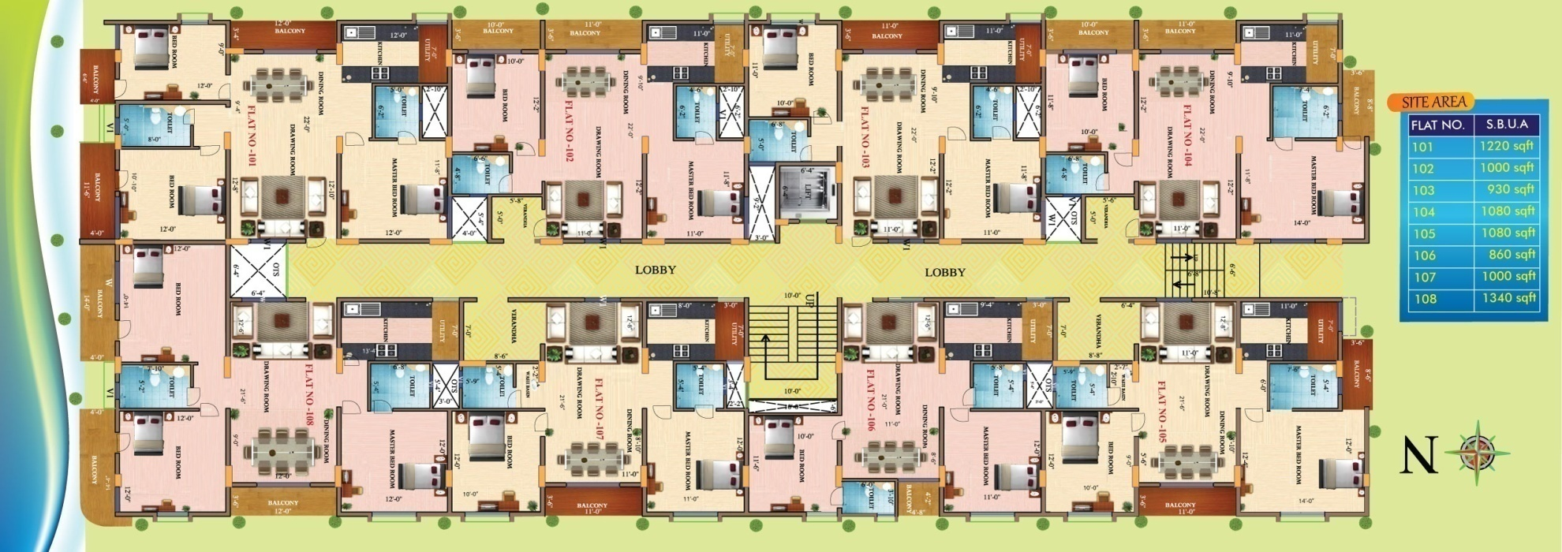
Layout plan:-

Slide 14
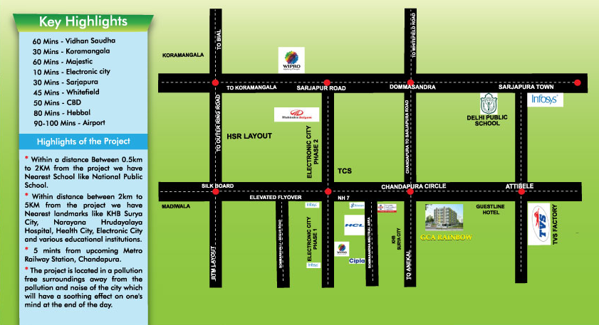
Location Map:-

Slide 15

For further clarification contact: Suma M S 9880256763 Team Leader - Marketing Venetion Group

